Slide 1


Mastering Multithreading in .NET: From Basics to Concurrency Architect
Bhushan Poojary

Slide 2

Introduction
"Welcome to Mastering Multithreading in C# and .NET! I’m Bhushan Poojary, your instructor for this deep dive into parallel and async programming.“

Slide 3

Problem Statement
"Have you ever faced UI freezes, slow services, or hard-to-diagnose bugs caused by bad threading? You're not alone."

Slide 4
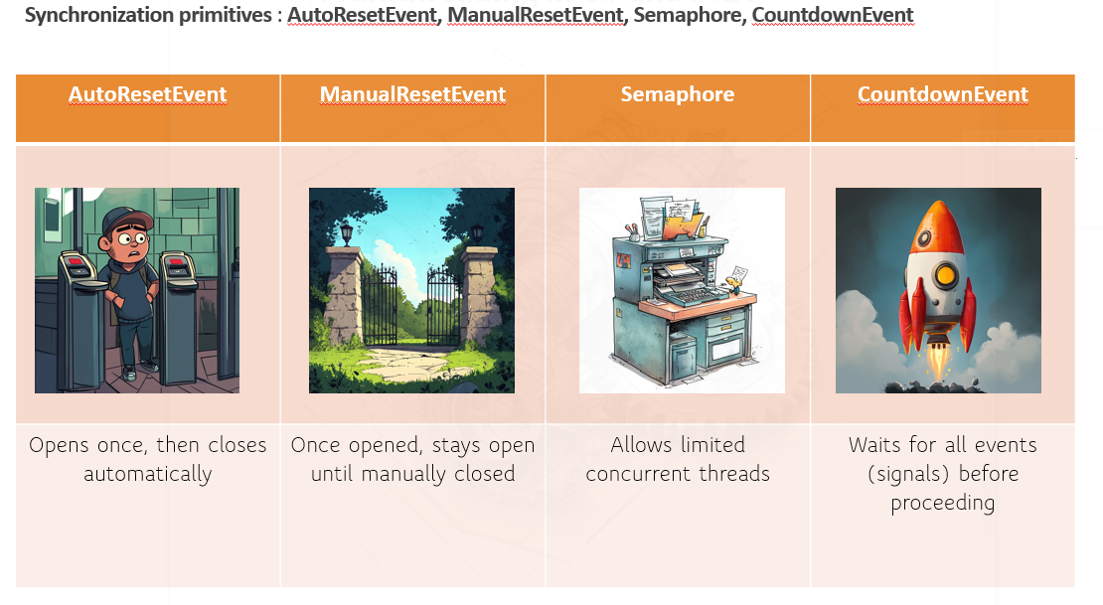
What will you Learn? Why This Course?
In this course, you’ll learn about threads, thread pools, async/await, synchronization tools like locks, semaphores, and how to debug race conditions, deadlocks, and memory issues.“
"This course is packed with real-world examples, analogies, demos, and best practices to help you master multithreading with confidence."

Slide 5

Join now and take your .NET skills to the next level!

Slide 6
Multithreading
What you will learn ?
What you all NEED?
Why Multithreading ?

Slide 7
Why Multithreading?
Multithreading is Key to Performance
Real-World Applications: | By the end of this course, you will:
Responsive UI applications Efficient background services Scalable backend systems | Understand how threads work Know when and why to use concurrency Avoid common multithreading pitfalls Write thread-safe, reliable code

Slide 8

Why Multithreading?
"Concurrency is not just about performance—it's about writing smarter, more resilient software."

Slide 9
What You'll Learn
What You'll Learn
Thread basics and life cycle
Synchronization and locks
Thread pool vs Task-based concurrency
async/await best practices
Capstone project and interview prep
Patterns, pitfalls, and real-world examples

Slide 10
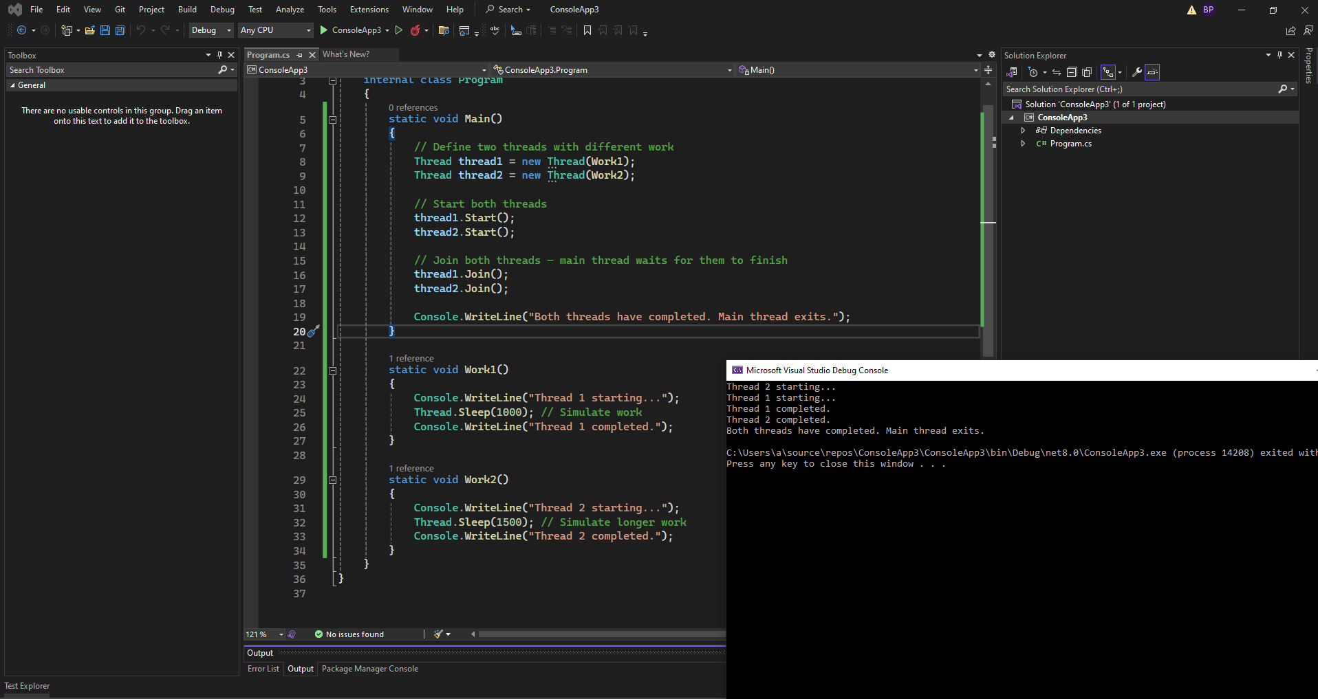

Code and Quiz

Slide 11

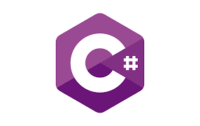

What You’ll Need
What You’ll Need
C#
Visual Studio 2022
.NET SDK 8.0

Slide 12

Resources
https://github.com/bhushanpoojary/MultiThreadingDotNet

Slide 13
See You in the Next Module!
"I'm excited to be your guide on this journey. Let’s dive into the world of multithreading and make your .NET apps faster and smarter. See you in the next module!"

Slide 14
Setting up the environment (Visual Studio, .NET SDK)
Name | Url
Visual Studio Community 2022 | https://visualstudio.microsoft.com/vs/community/
.NET SDK 8 | https://dotnet.microsoft.com/en-us/download/dotnet/8.0

Slide 15

Thread
Thread thread = new Thread(() =>
{
Console.WriteLine("Running in a separate thread");
});
thread.Start();
 | Pros and Cons
 | More control (e.g., priority, abort)
 | Higher overhead than thread pool

Slide 16
Thread Pool
In .NET, a Thread Pool is a pool of worker threads managed by the CLR (Common Language Runtime) that are used to perform tasks, process asynchronous calls, handle timers, and manage other background operations without the overhead of creating and destroying threads manually.
Key Characteristics:
Managed by .NET runtime: You don't need to create or destroy threads manually.
Reuses threads: It reuses threads to avoid the overhead of frequent creation and destruction.
Limits the number of concurrent threads: Prevents system overload by restricting the number of active threads.
Efficient for short-lived operations: Ideal for I/O-bound or short-running tasks.

Slide 17
Thread Pool
ThreadPool.QueueUserWorkItem(state =>
{
Console.WriteLine("Running in thread pool");
});

Slide 18
Thread Pool
How many threads are there at max in thread pool in given time in C# ?
ThreadPool.GetMaxThreads(out int workerThreads, out int completionPortThreads); ThreadPool.SetMaxThreads(100, 100);
How many threads are created by default minimum for a process ?
ThreadPool.GetMinThreads(out int workerThreads, out int completionPortThreads);
ThreadPool.SetMinThreads(8, 8); // Increases readiness to spawn more threads
How many threads are created by default minimum for a process ?
ThreadPool.GetMinThreads(out int workerThreads, out int completionPortThreads);
Worker threads: 1 × number of logical processors
I/O completion threads (IOCP): 1 × number of logical processors

Slide 19
Thread Pool
// Step 2: Offload email sending to ThreadPool
ThreadPool.QueueUserWorkItem(state =>
{
SendEmailConfirmation((Order)state);
}, order);
Why ThreadPool is a good fit here:
Email sending is a short-lived, non-blocking task.
ThreadPool reuses threads — no overhead of creating new threads each time.
It’s fire-and-forget — you don’t need a return value or error handling in the main thread.

Slide 20
Cons Thread Pool
No return value or result tracking
Unlike Task<T>, you can’t get the result of the operation.
No built-in way to await the completion.
No built-in error handling
If an exception occurs in the thread pool thread, it may go unobserved and crash the process unless handled carefully.
No cancellation support
You can’t easily cancel the work once it’s queued.
No fine-grained control
You can’t set thread priorities, thread affinity, or custom scheduling behavior.
Limited to short-lived tasks
ThreadPool is designed for fast, short tasks. Long-running tasks can block thread pool threads and exhaust available threads.
Difficult debugging and tracing
Since the threads are pooled and reused, stack traces and debugging behavior can be harder to follow.
No dependency injection or scoped lifetime support
In ASP.NET Core, ThreadPool threads don’t have access to scoped services. Using them can lead to service lifetime violations.

Slide 21
Why was Task introduced?
Threads: Manual, heavy, and harder to manage (e.g., synchronization, pooling, exceptions).
ThreadPool: Lightweight, reusable threads, but limited flexibility and control.
Tasks (via TPL - Task Parallel Library) were introduced in .NET 4.0 to:
Simplify asynchronous and parallel programming.
Use thread pool threads efficiently under the hood.
Provide a high-level abstraction over threads with more control,
cancellation, continuations, exception handling, and composability.
🧠 Analogy: If a Thread is like creating a new worker every time,
a Task is like managing a group of pre-hired workers via a smart manager (ThreadPool + TPL).

Slide 22
Basic Thread vs Task Comparison
Thread | Task
new Thread(() => { Console.WriteLine("Running in a Thread"); }).Start(); | Task.Run(() => { Console.WriteLine("Running in a Task"); });
Benefits of Task
Task is simpler.
Runs on ThreadPool.
Returns a Task object, allowing you to Use .ContinueWith() Await the result (await) Handle exceptions easily Use cancellation tokens

Slide 23
Real-World Use Case of Task
Task t1 = Task.Run(() => DownloadFile("file1.txt"));
Task t2 = Task.Run(() => DownloadFile("file2.txt"));
await Task.WhenAll(t1, t2);

Slide 24
Why Task over Thread Today
Why Task over Thread Today
Less error-prone
More scalable.
Integrates with async/await.
Built-in support for performance optimization and system resource reuse.

Slide 25
When to Use What
Use Thread if you need long-running, dedicated threads with full control.
Use ThreadPool for fire-and-forget background work.
Use Task for parallelism with return values and better exception handling.
Use async/await for asynchronous IO, cleaner code, and responsiveness.

Slide 26
Thread Life Cycle
Create
Running
Stopped

Slide 27
Background thread vs Foreground Thread
Background thread: Dies when application ends
Foreground thread: Keeps application active
When to use background thread?
Low-priority or auxiliary tasks E.g., logging, telemetry, or monitoring tasks that are useful but not critical if cut short.
Fire-and-forget scenarios Tasks that don't affect program correctness if they don't complete (like sending analytics data).
Graceful app shutdown Background threads allow the app to exit cleanly once all foreground work finishes, avoiding hanging due to non-essential threads

Slide 28

Mutex

Slide 29

SpinLock

Slide 30
SpinLock Important Points
SpinLock is a value type (struct), so do not store copies. Always use ref when calling Enter.
var copy = spinLock;
copy.Enter(ref lockTaken); // ❌ You're locking the COPY, not the original
Use only when:
The critical section is short.
Contention is low (not many threads competing).
Avoid on single-core systems, as spinning wastes CPU cycles.

Slide 31
SpinLock: when not to use
When the lock will be held for long.
In asynchronous methods (await, async) — SpinLock is not compatible.
When CPU efficiency is important and context switching is cheap.

Slide 32
Common Methods in Interlocked Class
Method | Purpose
Interlocked.Increment(ref int location) | Atomically increases value by 1
Interlocked.Decrement(ref int location) | Atomically decreases value by 1
Interlocked.Exchange(ref int location, int value) | Atomically sets a variable to a value
Interlocked.CompareExchange(ref int location, int value, int comparand) | Sets value only if the current value equals the comparand

Slide 33


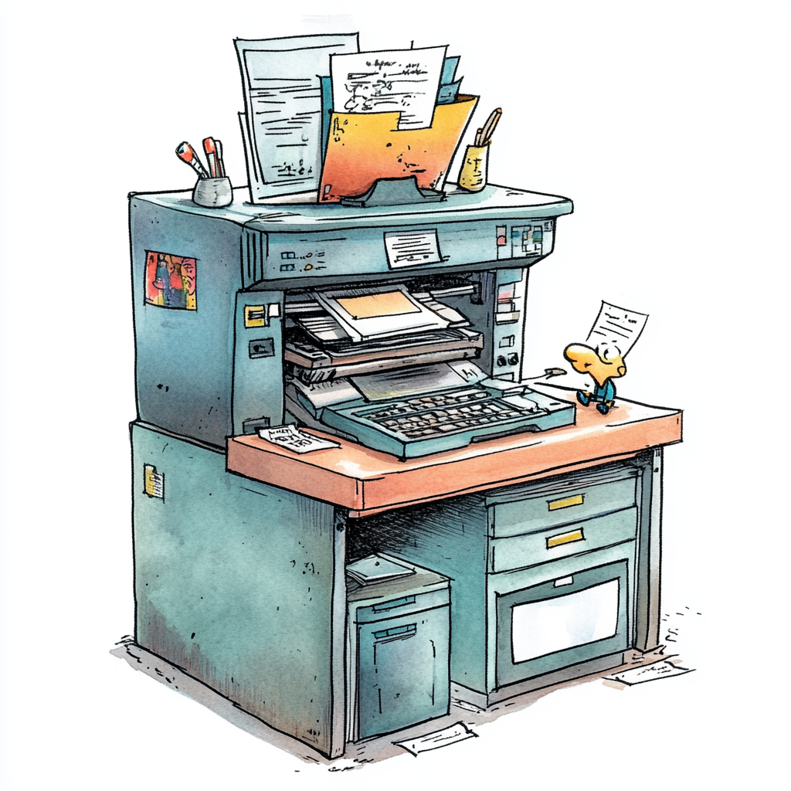

Synchronization primitives : AutoResetEvent, ManualResetEvent, Semaphore, CountdownEvent
AutoResetEvent | ManualResetEvent | Semaphore | CountdownEvent
Opens once, then closes automatically | Once opened, stays open until manually closed | Allows limited concurrent threads | Waits for all events (signals) before proceeding

Slide 34


Timers and Background Operations in .NET
Think of a timer as an alarm clock that triggers an event after a set time interval—and it can repeat. For example, checking your emails every 5 minutes.
Use case: Timers are ideal for recurring background tasks that don’t need direct user interaction—like:
Auto-saving a file every 10 seconds
Sending periodic health checks
Polling a server at intervals
Timers run on background threads and won’t block the main thread, allowing UI or server processes to continue smoothly.

Slide 35
Timers and Background Operations in .NET
Types of Timers in .NET
Timer Type | Namespace | Runs On | Use Case
System.Timers.Timer | System.Timers | ThreadPool thread | Server tasks, scalable apps
System.Threading.Timer | System.Threading | ThreadPool thread | Lightweight, low-level control
System.Windows.Forms.Timer | System.Windows.Forms | UI thread | Windows Forms UI-related tasks
DispatcherTimer | System.Windows.Threading | UI thread (WPF) | WPF UI-bound tasks

Slide 36

SynchronizationContext
Analogy: "Task Dispatcher"
Imagine you're working in an office with multiple departments:
UI Department → Handles user interface
Background Department → Handles calculations and IO
When a task completes, the dispatcher (SynchronizationContext) decides which department (thread) to return the result to.
For example:
In a UI app, updates must happen on the UI thread.
But background work (like file reading) happens elsewhere.

Slide 37
SynchronizationContext
Where It's Used
WinForms and WPF all have custom SynchronizationContexts.
Console apps usually don’t have one (returns null).
Why It's Important
Without SynchronizationContext, your app may:
Try to update UI from a non-UI thread (and crash).
Not maintain expected threading behavior.

Slide 38
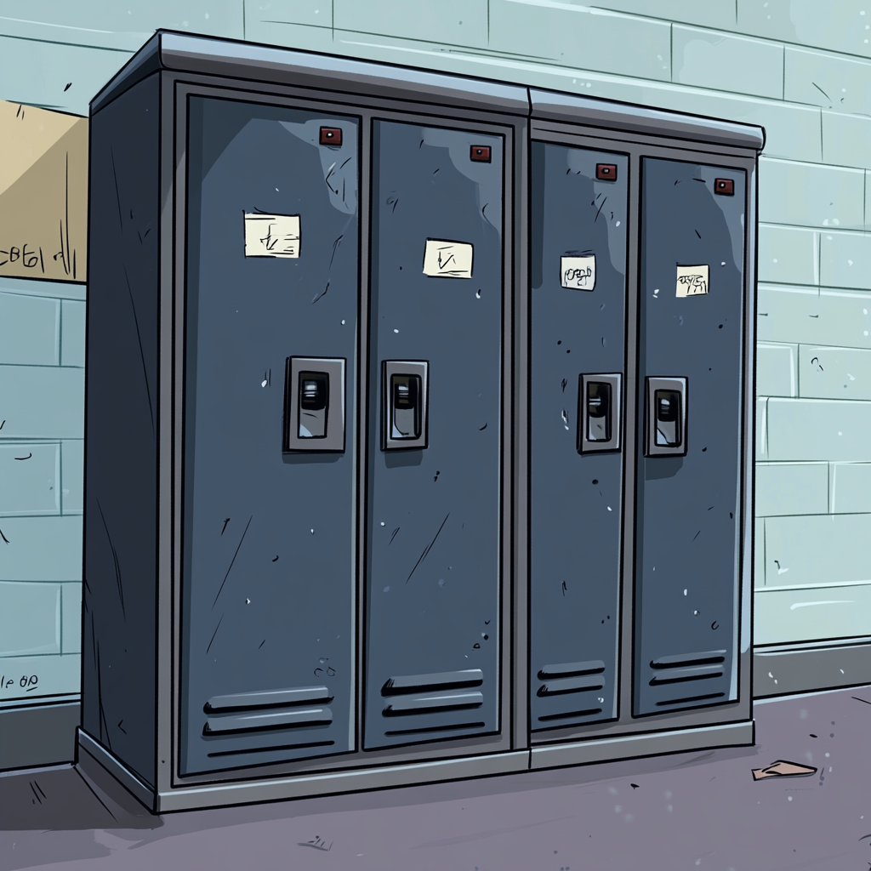
Thread-Local Storage (TLS)
Thread-local storage allows each thread to have its own independent copy of a variable, so threads don’t interfere with each other when accessing shared data.
Without TLS, multiple threads accessing the same variable might cause data corruption or race conditions.
With TLS, each thread gets its own sandboxed copy of the variable — no locking needed.
Analogy: "Thread’s Own Locker“ Imagine a gym locker room:
Each thread = person
Each locker = ThreadLocal<T>
Everyone has their own locker (data) — no conflicts or sharing.
So, even if 10 threads are using the same ThreadLocal<int>, each will have its own private int.

Slide 39
Thread-Local Storage (TLS)
Without TLS | With TLS
Random random = new Random(); Parallel.For(0, 10, i => { Console.WriteLine(random.Next()); // Not thread-safe }); | ThreadLocal<Random> localRandom = new ThreadLocal<Random>(() => new Random()); Parallel.For(0, 10, i => { Console.WriteLine(localRandom.Value.Next()); // Each thread gets its own Random });
Using Random in multiple threads without TLS causes duplicate or corrupted values.

Slide 40
Thread-Local Storage (TLS)
Used in caching, loggers, random number generation, etc.
When to Use / Avoid
Use TLS when... | Avoid TLS when...
Threads need private state/data | You actually want shared data
You want to avoid locks | Memory usage is a concern (copies per thread)
High-performance parallelism (e.g., Parallel.For) | You need data to be passed between threads
ThreadLocal<T> allows each thread to safely maintain its own copy of a variable.
It’s ideal when you want thread isolation without needing synchronization.

Slide 41

Introduction to Task Parallel Library
Real-World Analogy
Think of Task like hiring a helper to do a job while you continue your work. Once the helper finishes, you can check the result, handle any issues, or chain more work.

Slide 42
Introduction to Task Parallel Library
What is TPL?
The Task Parallel Library is a set of public types and APIs in the System.Threading.Tasks namespace that simplifies writing concurrent and parallel code. It was introduced in .NET Framework 4.0.

Slide 43
Introduction to Task Parallel Library
Why TPL is needed?
Manual threading with Thread class is error-prone.
Thread pool (ThreadPool.QueueUserWorkItem) lacks modern constructs like return values, continuations, or exception handling.
TPL provides an abstraction over threads using Task and Task<TResult>, making it easier to manage asynchronous operations.

Slide 44

What are Task Continuations?
A continuation is a task that starts after another task finishes. It's a way to chain tasks so that each task waits for the previous one to complete before running.
Analogy: Imagine you order a pizza online (Task 1). Once it's delivered, you eat it (Task 2). Eating depends on the delivery finishing — this is a continuation.

Slide 45
Task Continuations
Compare ContinueWith vs await
// Using await (more readable)
async Task Run()
{
int result = await Task.Run(() => 10);
Console.WriteLine($"Result: {result}");
}
ContinueWith is useful for fine-grained control, especially for scheduling or conditional branching.
await is cleaner and preferred for most high-level code.

Slide 46


Parallel.For, Parallel.ForEach, and PLINQ
Normal loop: One person (single thread) does all envelopes one by one.
Parallel loop: 4 people work in parallel, each handling 25 envelopes — faster completion.
What Does "Parallel" Mean?
Parallelism = Executing multiple operations simultaneously on multiple cores of the CPU.
This is different from multitasking, where tasks are interleaved on the same core.

Slide 47
⚠️Important Points to Paralell and PLINQ
Topic | Explanation
No guaranteed order | Unless .AsOrdered() is used (PLINQ)
Thread safety | Shared variables must be protected (e.g., with lock)
Use only for CPU-bound tasks | Not ideal for I/O-bound workloads
Don’t use inside UI thread directly | Avoid freezing WinForms/WPF apps

Slide 48
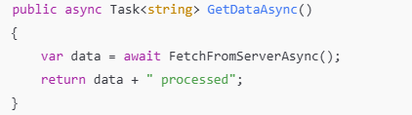
Async/Await as a State Machine
The compiler rewrites this into something similar to a state machine. Each await point becomes a state transition, and the compiler creates a hidden IAsyncStateMachine implementation.

Slide 49
Async/Await as a State Machine
What Happens Internally
Method is split into states:
The code before await is one state.
The code after await is another.
Each await introduces a new state.
The compiler generates a struct/class that:
Implements IAsyncStateMachine
Contains fields for method variables and a state field
Contains a MoveNext() method to transition between states
The await keyword does not block:
It yields control to the caller.
When the awaited task completes, the state machine resumes from where it left off.

Slide 50
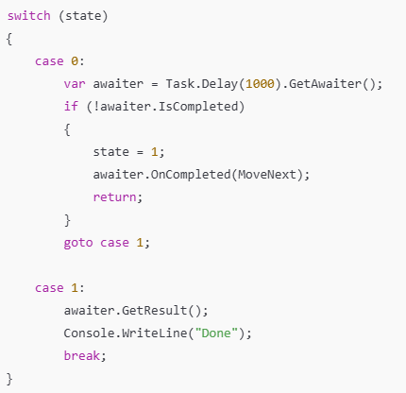
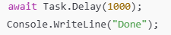
Async/Await as a State Machine

Slide 51

BlockingCollection<T>
Analogy: Restaurant Kitchen
Producer = Chef: Cooks meals and places them on the serving counter (the shared buffer).
Consumer = Waiter: Picks up meals from the serving counter and serves them to customers.
BlockingCollection<T> = Serving Counter (bounded or unbounded): A thread-safe queue that can block chefs

Slide 52
BlockingCollection<T>
Chefs (Producers) might be faster or slower depending on the complexity of the meal (simulates varying production speed).
Waiters (Consumers) might come fast or slow (simulates varying consumption speed).
The serving counter automatically:
Blocks chefs if it’s full (backpressure).
Blocks waiters if it’s empty (waits for production).
This directly maps to BlockingCollection<T>:
Add() blocks if the collection has reached its bounded capacity.
Take() blocks if the collection is empty.
Why This Analogy Works:

Slide 53
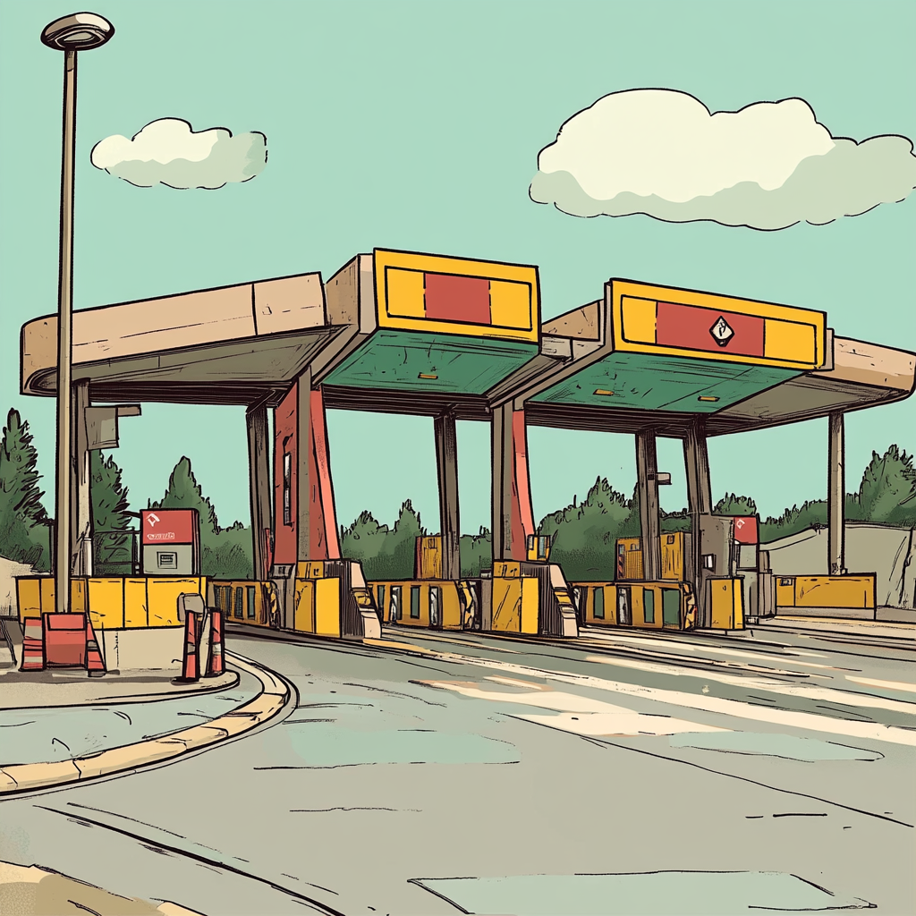

ConcurrentDictionary<TKey, TValue>
Imagine a multi-lane toll booth (ConcurrentDictionary) vs. a single-lane toll booth (regular Dictionary). With multiple lanes, many cars (threads) can pay tolls (access data) at the same time — efficiently and safely.
Concept:
A thread-safe dictionary for use in multi-threaded scenarios, where multiple threads can safely read and write key-value pairs simultaneously.
Why Not Use Dictionary<TKey, TValue> in Threads?
Dictionary is not thread-safe. If one thread modifies it while another reads, it may throw exceptions or corrupt data.

Slide 54
ConcurrentDictionary<TKey, TValue>
What Makes ConcurrentDictionary Special?
Multiple readers and writers can operate without locking the whole dictionary.
Internally uses lock striping (fine-grained locks on buckets).
Provides atomic operations like:
TryAdd
TryUpdate
GetOrAdd
AddOrUpdate

Slide 55
ConcurrentDictionary<TKey, TValue>
Use Cases:
Caching shared data accessed by multiple threads
Counting frequency of words/logs in parallel processing
Maintaining session/token maps in web servers

Slide 56
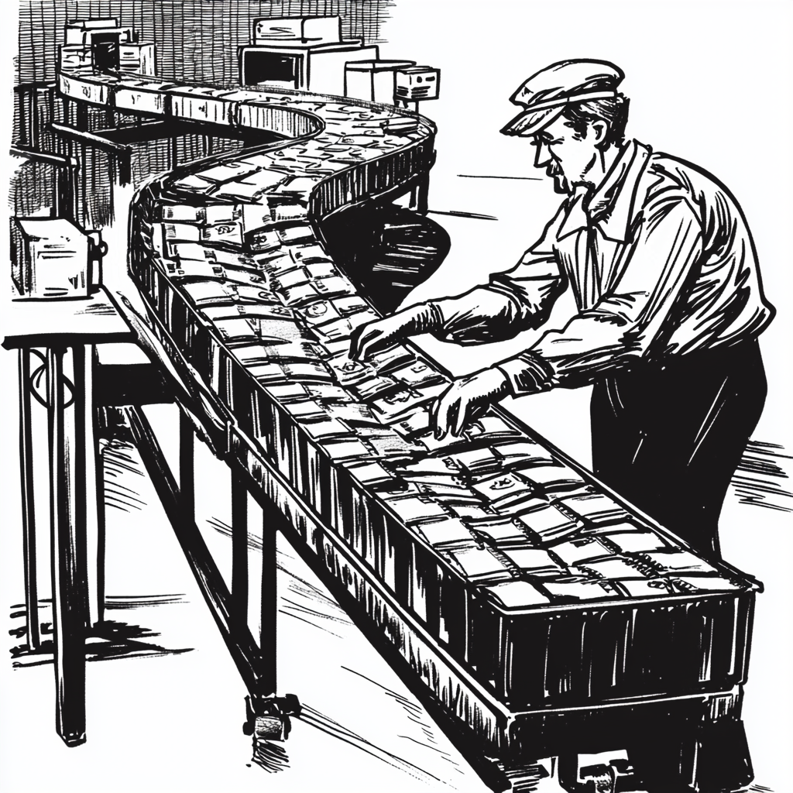
ConcurrentQueue<T>
Analogy:
Think of a conveyor belt in a factory:
Multiple workers (threads) can put items on the belt (enqueue).
Other workers pick them up in the same order (dequeue).
No collisions or confusion on item order.

Slide 57
ConcurrentQueue<T>
Key Features:
No need for explicit locks
Non-blocking (unlike BlockingCollection)
Methods:
Enqueue(item)
TryDequeue(out T result)
TryPeek(out T result)

Slide 58
ConcurrentQueue<T>
Use Cases:
Event queues in GUI/messaging systems
Logging from multiple threads
Task scheduling where order matters

Slide 59

CancellationToken and cooperative cancellation
Imagine you're working in a team, and your team leader says, “If I raise the red flag, stop what you’re doing!”
That red flag is like a CancellationToken. You're not being forced to stop — you check occasionally and stop yourself cooperatively. This is what we mean by cooperative cancellation

Slide 60

Creating responsive UIs in WPF and WinForms
What is a Responsive UI? Responsive UI means:
The application stays interactive (doesn’t freeze or hang) while it's doing background work.
Buttons can be clicked, windows can be moved, progress bars can update — even while data is loading, files are being read, or network requests are happening.
Analogy: Think of a restaurant — the waiter (UI thread) should still take new orders even while the kitchen (background thread) is cooking.

Slide 61
Creating responsive UIs in WPF and WinForms
Why UIs Freeze?
In both WPF and WinForms, the UI runs on a single thread — called the UI thread. If you block this thread with:
Thread.Sleep
File.ReadAllText
.Result on async tasks
the entire app becomes unresponsive until the task is done.

Slide 62
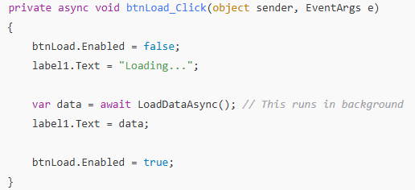
Creating responsive UIs in WPF and WinForms
How to Make it Responsive?

Slide 63

Debugging and profiling multithreaded apps
❓ “Why is debugging multithreaded code hard?”
Because:
Multiple threads can run at the same time.
Bugs may appear randomly (called Heisenbugs).
You might not see the problem every time you run it.
Race conditions, deadlocks, and thread starvation are hard to reproduce.
🧠 Analogy: Like watching a movie with multiple screens playing simultaneously — it’s hard to track who did what and when.

Slide 64
Debugging and profiling multithreaded apps
Thread Window (Visual Studio)
Breakpoints + Conditional Breakpoints
Call Stack Window
Parallel Watch and Tasks Windows

Slide 65
Common Bugs and How to Catch Them
Bug Type | Description | How to Detect
Race Condition | Two threads access shared data simultaneously | Random inconsistent results
Deadlock | Threads wait on each other forever | App freezes, no CPU usage
Starvation | Low-priority thread never gets CPU time | Thread exists but never finishes
UI Thread Freeze | Heavy work on UI thread | App becomes unresponsive

Slide 66
Profiling Multithreaded Apps
Use profilers to measure performance and identify bottlenecks.
🔧 Tools:
Visual Studio Diagnostic Tools
PerfView
JetBrains dotTrace
Windows Performance Analyzer (WPA)
What to Look For:
Thread utilization
Blocking/sleeping threads
CPU/memory usage per thread
Long-running background threads

Slide 67
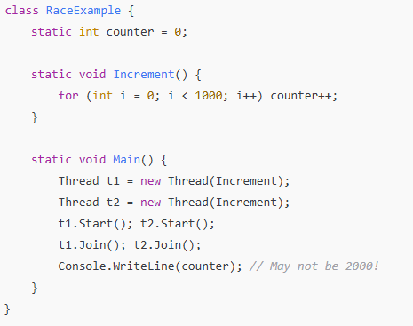
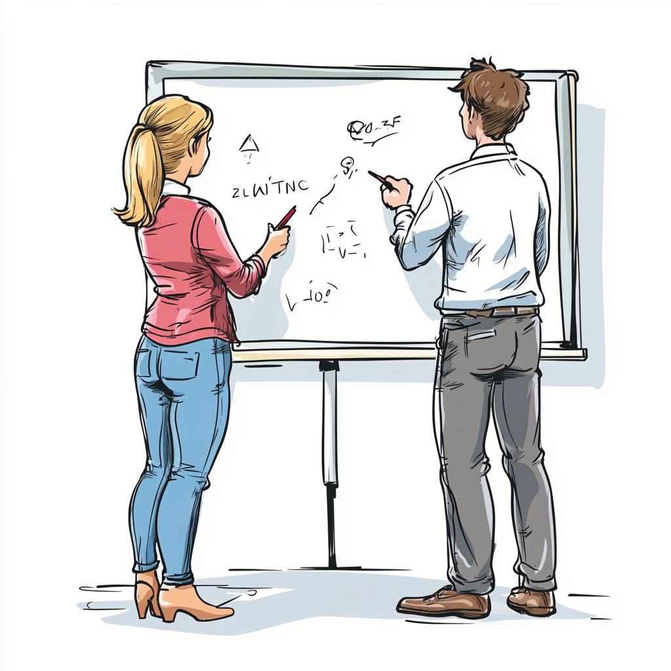
Race Conditions
Analogy: Two people writing on the same whiteboard at the same time.

Slide 68

Deadlocks: Circular Wait
Analogy: Two people each holding one half of a pair of scissors, refusing to let go while waiting for the other.

Slide 69

Starvation: Never Getting a Turn
Analogy: A kid in the lunch queue who’s always pushed aside by others.

Slide 70
Starvation: Never Getting a Turn
Starvation happens when a thread waits indefinitely for a resource because other higher-priority threads keep taking it.
Often due to lock unfairness or aggressive resource usage by other threads.
Example:
A low-priority thread trying to acquire a lock that's constantly being taken by a high-priority thread.
Hard to demonstrate in a simple example, but you can simulate it by making one thread acquire a lock repeatedly with Thread.Sleep.
Solution:
Use fair locking mechanisms (Semaphore, Mutex, or lock ordering).
Avoid long-held locks in high-priority threads.

Slide 71

What is a Thread Leak?
Analogy: Think of each thread as a worker you hire. If you keep hiring workers (creating threads) and never let them go (terminate or return them), your office (system) will eventually run out of desks (resources).

Slide 72
Thread Leak
A thread leak occurs when threads are created but never terminated or returned to the thread pool. This leads to resource exhaustion — similar to opening tabs in a browser and never closing them.
👎 Common Causes:
Creating threads manually with new Thread() but never letting them exit.
Using ThreadPool or Task without awaiting or managing them properly.
Threads waiting forever due to blocking conditions or deadlocks.
✅ How to Prevent:
Always design threads with a way to exit (like using CancellationToken).
Prefer Task and async/await with ConfigureAwait(false) in libraries.
Use Thread.Join() or Task.Wait() only when appropriate.
Avoid infinite loops without exit logic.

Slide 73
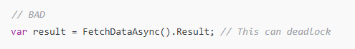
Misusing async/await
1. Blocking with .Result or .Wait()
Problem: Mixing synchronous and asynchronous code.
Why it’s bad:
Can cause deadlocks in UI apps.
Blocks the calling thread (defeats the purpose of async).

Slide 74
Misusing async/await
How to fix:

Slide 75
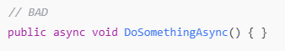
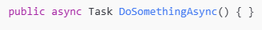
Misusing async/await
2 Returning void instead of Task
Why it's bad:
async void should be used only for event handlers.
You can’t catch exceptions or await them.

